Slide 1
Information and Communication Technology: A Hands-On Introduction to Making Word and PDFs Accessible

Slide 2
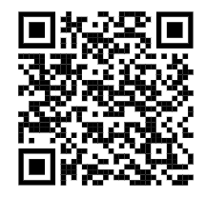
To Read Along…
Visit this page and download the PowerPoint!
https://assistivetechnology.oakhillct.org/downloads/

Slide 3
Introductions
Steve Famiglietti
Adam Kosakowski
NEAT- New England Assistive Technology
Connecticut Tech Act Project

Slide 4
Screen Reader Demonstration

Slide 5
Web Content Accessibility Guidelines
Also known as WCAG
A great place to learn about WCAG is WebAIM
International standards for digital accessibility
Following these guidelines will allow people with disabilities to access digital documents and protect organizations from litigation
Helps organizations reach compliance under laws like Section 508 and the ADA

Slide 6
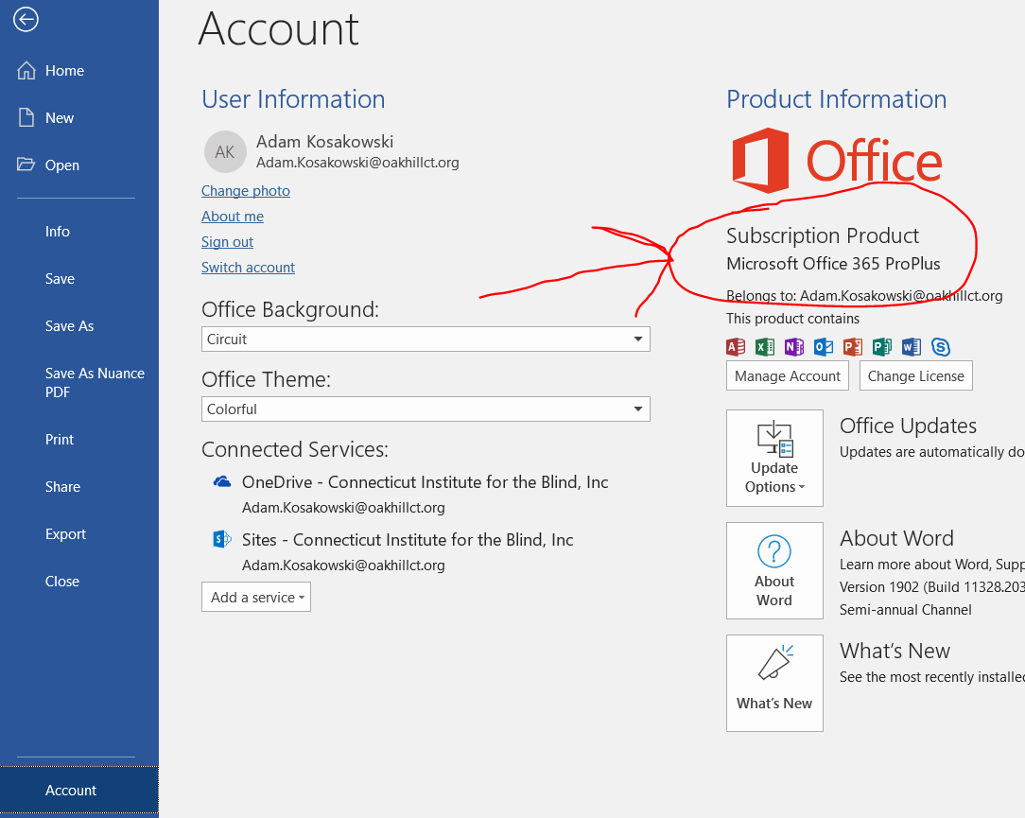
A Note on Word Versions and This Training
Each version is different
“Online Word” and different versions of “desktop Word”
Accessibility needs are the same
Take the vocabulary you learn with you
File > Account > Product Information

Slide 7
Today’s Plan
Learn a way to add accessibility to a Word document
Practice that skill
Prizes for participation!
Go back to step one and repeat!
There will be a short break at some point
Raise your hand if you have any questions at any time!

Slide 8
What Makes an Accessible Document
Heading structure by the use of styles
List structure
Alternative text
Data table – basic
Appropriate link text

Slide 9
What Makes an Accessible Document continued…
Color use
Color contrast
Document title
Layout tables (please don’t do that) and columns
Multimedia (audio and video)
Plain language

Slide 10
Only Color Conveying Meaning
Notes:
Adam 1

Slide 11
Only Color Conveying Meaning, 2
Notes:
Adam

Slide 12
Only Color Conveying Meaning, 3
Notes:
Adam
Word Online: Graphs don’t work. Use Color Analyzer to confirm that there is not enough contrast between the lines.
Word 2016: Options:
Labels: Click + to the right of chart > hover mouse over choices to see preview > click to select (Example: Turn on chart title!)
Shapes: Right click line > Format Data Series > paint can > Marker > Marker Options > Built-in > Type and size, select appropriate
Colors: Right click line > Format Data Series > paint can > Line > Color, select appropriate (Use CCA software to text for WCAG compliance)

Slide 13
Only Color Conveying Meaning, 4
Notes:
Adam

Slide 14
Tips to Make Desktop Word Tables Accessible
Labels: Click + to the right of chart > hover mouse over choices to see preview > click to select
Shapes: Right click line > Format Data Series > paint can (Fill & Line) > Marker > Marker Options > Built-in > Type and size, select appropriate
Colors: Right click line > Format Data Series > paint can > Line > Color, select appropriate (Use Color Contrast Analyzer software to text for WCAG compliance, see slide 17)

Slide 15
Color Contrast
Color contrast is the difference in perceived brightness between two colors
Terms typically used are foreground and background
The minimum color contrast is 4.5:1
Notes:
Adam

Slide 16
Contrast Examples
21:1
The quick brown fox jumps over the lazy dog
4.5:1
The quick brown fox jumps over the lazy dog
2.8:1
The quick brown fox jumps over the lazy dog
1.5:1
The quick brown fox jumps over the lazy dog
Notes:
Adam

Slide 17
Color Contrast Tools and Tip
Tools
The Paciello Group – Colour Contrast Analyzer
Logos are exempt from color contrast
Notes:
Adam
To download: https://github.com/ThePacielloGroup/CCAe/releases/latest (or Google Color Contrast Analyzer Paciello Group)
In GitHub, click on the setup exe
Tips: Use the eye dropper tool > click on a color to see exact stats

Slide 18
Practice! Color Accessibility
Notes:
Adam
Word Online: Graphs don’t work. Use Color Analyzer to confirm that there is not enough contrast between the lines.
Word 2016: Options:
Labels: Click + to the right of chart > hover mouse over choices to see preview > click to select (Example: Turn on chart title!)
Shapes: Right click line > Format Data Series > paint can > Marker > Marker Options > Built-in > Type and size, select appropriate
Colors: Right click line > Format Data Series > paint can > Line > Color, select appropriate (Use CCA software to text for WCAG compliance)

Slide 19
Alternative Text and Text Equivalents
Alternative text provides a non-visual means of representing the content or function of an image
Alternative text should be present for anything that conveys information
In Microsoft Word, the following are considered elements that can hold alt text
pictures, illustrations, images of text, shapes, charts, SmartArt, embedded objects
Alt Text needs to be concise and meaningful
Online Word: left click image, go to Picture ribbon > Alt Text > Type alt text into Description field
In Word 2013 and 2016 you access the alt text options through the Application Menu (right click) > Format Picture (left click) > Layout and Properties (Shift+F10, O, Shift Tab, Right Arrow to Layout and Properties, Tab to Description)
After Word 2016 you access the alt text options through the Application Menu (right click) > Edit Alt text
Notes:
Steve 1

Slide 20
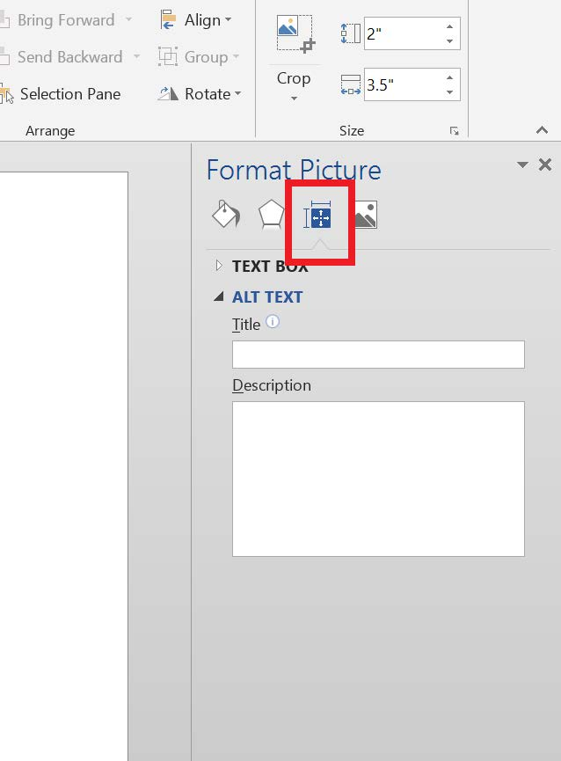
Alternative Text in Word 2013 and 2016
Select a picture > Right click (context menu) > Format Picture > Layout and Properties > Alt Text
Notes:
Steve
What version Office will our training students have?

Slide 21
Alternative Text Secrets in “Older Versions”
When putting in alternative text, make sure you put it in the description not in the title
When the Microsoft Word Accessibility Checker says that you have an error because your table is missing alternative text, you can ignore it
Notes:
Steve

Slide 22
Practice! Alternative Text
Notes:
Steve
Online Word: left click image, go to Picture ribbon > Alt Text > Type alt text into Description field
In Word 2013 and 2016 you access the alt text options through the Application Menu (right click) > Format Picture (left click) > Layout and Properties (Shift+F10, O, Shift Tab, Right Arrow to Layout and Properties, Tab to Description)
After Word 2016 you access the alt text options through the Application Menu (right click) > Edit Alt text

Slide 23
Styles or “Heading Structure”…
Styles create document structure in your document
In the styles menu there are lots of options - we want to know about the Headings specifically H1 – H6
Styles or document structure allows for the document to be navigated by assistive technology in an efficient way.
In online Word, you access the styles menu through the Home Tab > Combo box where you’ll see “Heading 1”
In desktop Word, you access the styles menu through the Home Tab > Styles Menu (Alt, H, L)
Notes:
Steve 2

Slide 24
Styles Menu in Word
Online Word
Desktop Word
Notes:
Steve

Slide 25
Practice! Headings
Notes:
Steve

Slide 26
Lists…
Lists and Columns are used to break up and simplify content
Lists group items in ordered (numbered) lists or unordered (bulleted) lists
When creating lists, make sure you use the built in tools to create them - using the tool will mark up the back end for assistive technology
In online Word, you access list options through Home Tab > Bullets icon
In desktop Word, you access list options through Home Tab > Paragraph Menu > Bullets, Numbering, or Multilevel List (Alt, H, U = Bullets, Alt, H, N = Numbering, Alt, H, M = Multilevel List)
Notes:
Steve 3

Slide 27
Lists in Word
Online Word
Desktop Word
Notes:
Steve

Slide 28
Practice! Lists
Notes:
In online Word, you access list options through Home Tab > Bullets icon
In desktop Word, you access list options through Home Tab > Paragraph Menu > Bullets, Numbering, or Multilevel List (Alt, H, U = Bullets, Alt, H, N = Numbering, Alt, H, M = Multilevel List)

Slide 29
Data Table – BASIC
Tables are used to display data in an organized way
When using tables in Word, best practice is to make it a simple data table, no merging or splitting of cells
Best practice is to always insert a table, or you can use the graph paper to create your table
Online Word: Left click any cell, go to Table ribbon > Style Options. Select Header Row
Desktop Word: Right click a cell in the top row > Table Properties:
Under row tab, uncheck “allow row to break across pages”
Under row tab , check “repeat as header on the top of each page”
Notes:
Steve 4

Slide 30
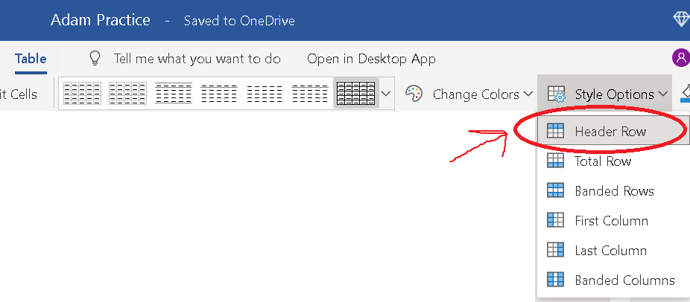
Data Table in Online Word

Slide 31
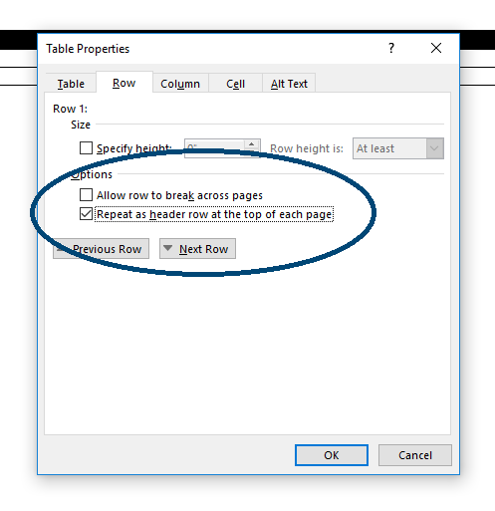
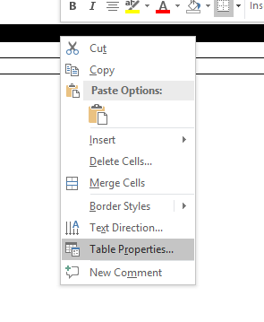
Data Table in Desktop Word
Notes:
Steve

Slide 32
Data Table - Basic
Employee Name | Start Month | Start Year
John Doe | July | 2014
Jane Doe | April | 2005
Mark Doe | November | 2009
Notes:
Steve

Slide 33
Practice! Data Tables
Notes:
For table, encourage them to put something in top left cell, like “Type of Tornadoes”
Online Word:
Left click any cell, go to Table ribbon > Style Options. Select Header Row
Desktop Word:
Right click a cell in top row to get to Table Properties
Under table’s Design ribbon, choose a nice Table Style with high contrast borders
Make header row bolded for pop

Slide 34
Appropriate Link Text
Typically, users make links by typing the full uniform resource locator (URL) and hit the space bar - Word then converts it to a link automatically
Typing a full URL can be confusing for users of assistive technology - this is why it is important to use and understand links that describe the function, destination, or purpose
Online Word: To set appropriate link text go to Insert Tab > Link
Desktop Word: To set appropriate link text go to Insert Tab > Links Menu > Hyperlink or Link (Alt, N, I)
Hint: When inserting link text, make sure that there are no spaces in the URL, especially at the end
Confusing Link
https://assistivetechnology.oakhillct.org/digital-accessibility/
Helpful Link Text
NEAT Digital Accessibility Services
Notes:
Steve 5

Slide 35
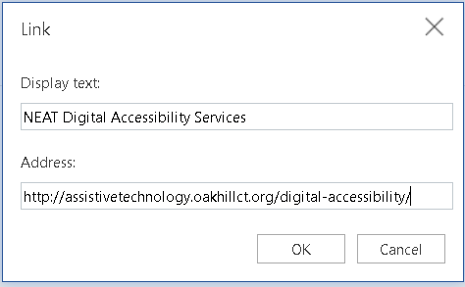
Inserting a Link in Online Word

Slide 36
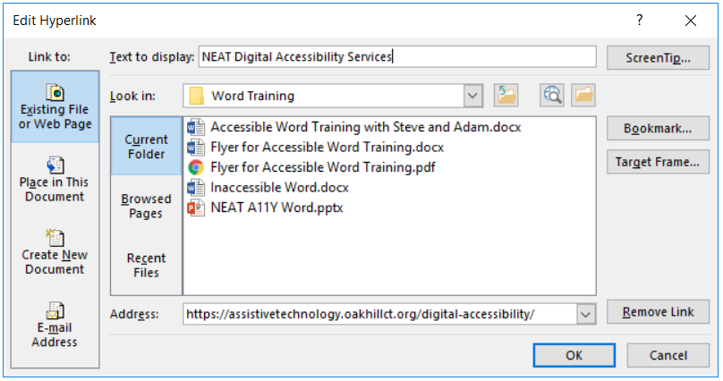
Inserting a Link in Desktop Word
Notes:
Steve

Slide 37
Practice! Inserting Link Text

Slide 38
Columns in Desktop Word
Notes:
Adam 2

Slide 39
Table for Layout in Word
 |  | Alright?
 | This
Is

Slide 40
Tables for Layout and Columns
Tables for layout and columns allow you to design a document and affect the reading flow
Using tables for layout is an advanced feature and can cause accessibility issues very quickly
Columns are useful but need to be created using the tools inside Word so reading order is correct
To add columns in desktop Word you go through Page Layout Tab > Page Setup Menu > Columns (Alt, P, J)

Slide 41
Plain Language
Before
When the process of freeing a vehicle that has been stuck results in ruts or holes, the operator will fill the rut or hole created by such activity before removing the vehicle from the immediate area.
After
If you make a hole while freeing a stuck vehicle, you must fill the hole before you drive away.
Notes:
Adam 3

Slide 42
Built In Microsoft Accessibility Checker
Microsoft Word has a tool that will help you check the basic accessibility of your word document
This tool checks against three sets of possible issues
Errors - Content that in most (but not all) cases makes the document difficult to understand for people with disabilities
Warnings - Content that in most (but not all) cases makes the document difficult to understand for people with disabilities
Tips - Content that people with disabilities can understand but that could be presented in a different way to improve the user’s experience
The accessibility checker is a place to start - it is not always right and can make the novice worry about things that are unnecessary
To access the Accessibility Checker in newer versions of desktop Word and online Word, go to the Review Ribbon > Check Accessibility

Slide 43
Desktop Word: Document Title and File Name
There is a visible title (H1) and there is a document properties title
Document properties title is used when converting your Word document to PDF
On desktop Word, document title is added by going to File > Info > Properties (Alt, F, I, S, 1)
Notes:
Adam 4

Slide 44
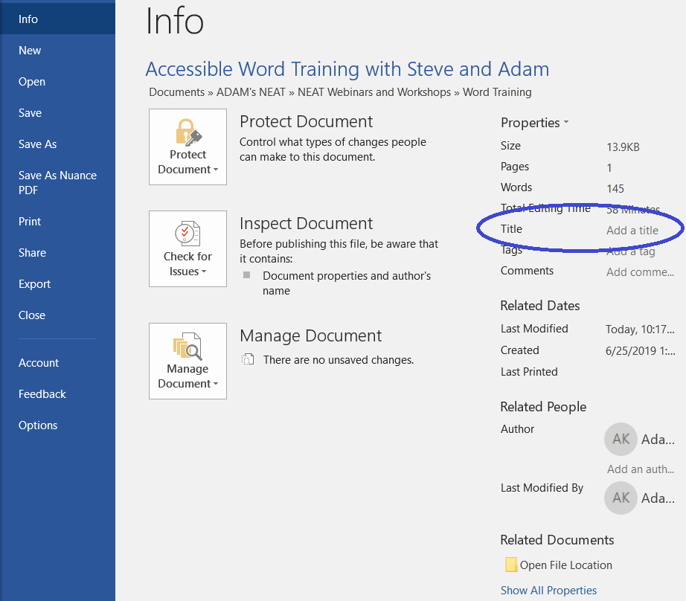
Adding Title in Desktop Word

Slide 45
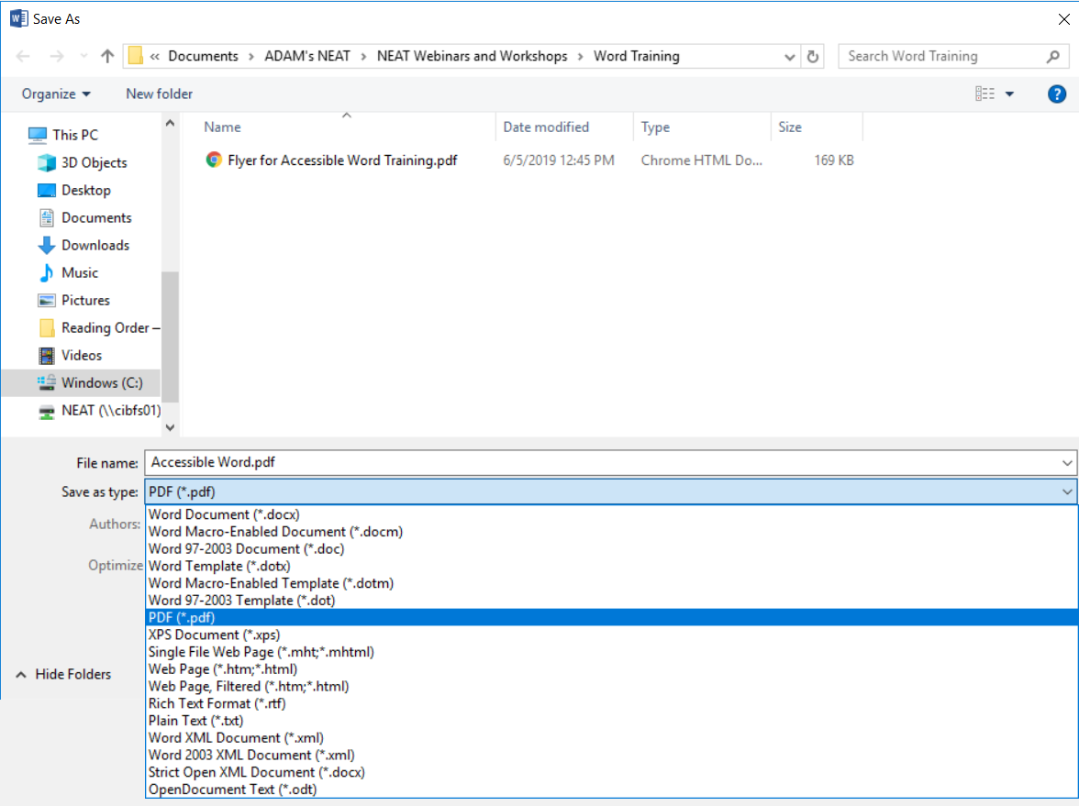
File…Save As…PDF

Slide 46
Practice! Document Title and Save As PDF
Let’s finish off this document!

